Slide 1
MECE Olympics Sport Analysis for 2020
Total Athletes Participating – 11,326
2021 Olympics Events‎ - 339 in 33 Sports
Olympics Parade of Nations – 205 Countries
Top 5 Countries participation in Olympics
United States - 613
Japan - 552
Australia - 478
China - 406
France- 398
Bottom 5 countries participation in Olympics
Andorra-2
Somalia-2
Solomon Islands -2
Nauru – 2
Tuvalu- 2

Slide 2
MECE Sport Analysis
Summer Olympics
Game Analysis
Athletics (Track and Field),
Swimming,
Gymnastics,
Cycling,
Basketball,
Football (Soccer),
Tennis,
Boxing,
Wrestling,
Volleyball,
Volleyball,
Rowing,
Sailing,
Fencing,
Shooting,
Equestrian,
Archery,
Taekwondo and Judo,
Canoeing and Kayaking,
Table Tennis,
Badminton, and Field Hockey
Winter Olympics
Skiing, Snowboarding, Ice Skating, Bobsleigh, Luge, and Skeleton, Ice Hockey, Curling, Biathlon, Nordic Combined

Slide 3
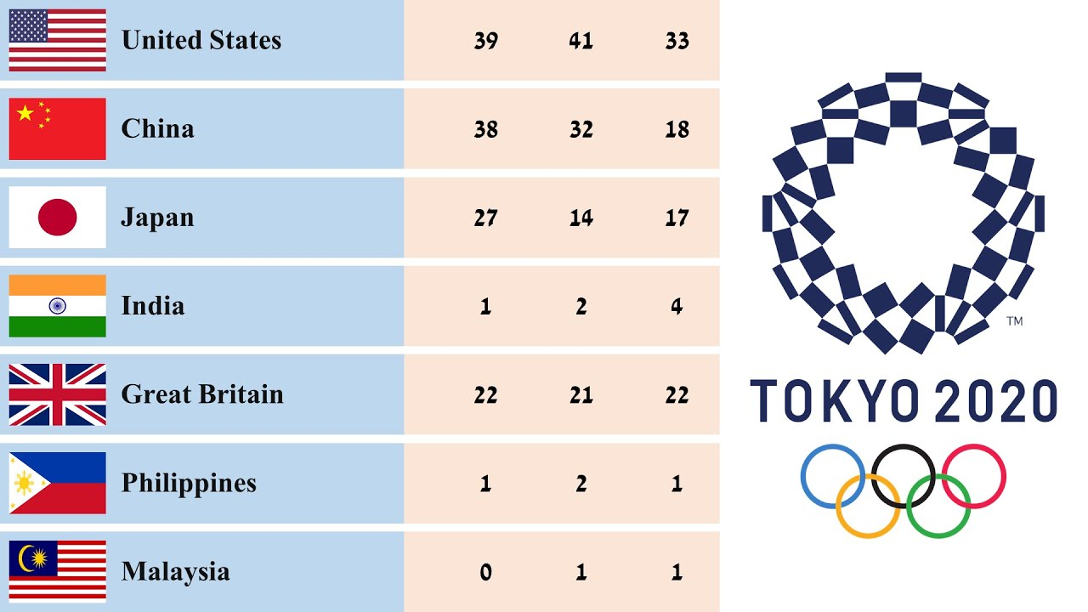
Medal types
According to 2020 the number of medals won by each country
Gold
Silver
Bronze

Slide 4
The scheduling of Olympic events is typically the responsibility of the International Olympic Committee (IOC), in collaboration with the host city's organizing committee. The IOC plays a crucial role in coordinating and overseeing the entire Olympic Games, including the schedule, competitions, and logistics.
The process involves a structured planning phase, where the IOC, along with the organizing committee, establishes the event schedule. They consider various factors, such as the number of sports, disciplines, venues, athletes' participation, broadcasting requirements, and logistical arrangements
Event analysis

Slide 5
OFFICIAL PROGRAMME OF THE OLYMPIC GAMES TOKYO 2020 Out of a total of 1410 athletes, there are 664 men and 732 women participating in the Aquatics events.
Participate Analysis
Indoor Sports
Gymnastics, Volleyball, Basketball, Badminton, Table Tennis
Sport Analysis
Outdoor Sports
Athletics/Track and Field, Swimming, Football (Soccer),Cycling (Road Events),Sailing

